Slide 1

DATA SCIENCE FINAL capstone project
BHARAT WANWARI

Slide 2
Introduction
Scenario:
My name Bharat wanwari, currently live in Delhi, India. My family runs a cake bakery shop in delhi.
The cakes are of different shapes, taste, customised and prices. Also the material used in preparation is obtained from various part of india and are mostly in bulk.
Business Problem:
My Family wants to grow the business in india and then in other countries. The challenge is to find the starting point for the growth. where the population in other states is more as compared with Delhi is high and preferences of people are technically suitable to sweet/bread/cream products.
Interested Audience
I believe the audience will all those person those who wants to grow business in other regions and that Data analysis.

Slide 3
Data Required
The following data is required to answer the issues of the problem:
List of states of India with census.
List of states of India with temperature.
List of preferences of people of India state wise.

Slide 4
Methodology
Using the Below Libraries in python and using the Data required
Pandas
Geopy
The data required is stores as below in the Github repository.
https://raw.githubusercontent.com/BHARATW1993/mygit/master/data%20capstone%20project1.csv
https://raw.githubusercontent.com/BHARATW1993/mygit/master/data%20capstone%20project2.csv
https://raw.githubusercontent.com/BHARATW1993/mygit/master/data%20capstone%20project3.csv

Slide 5
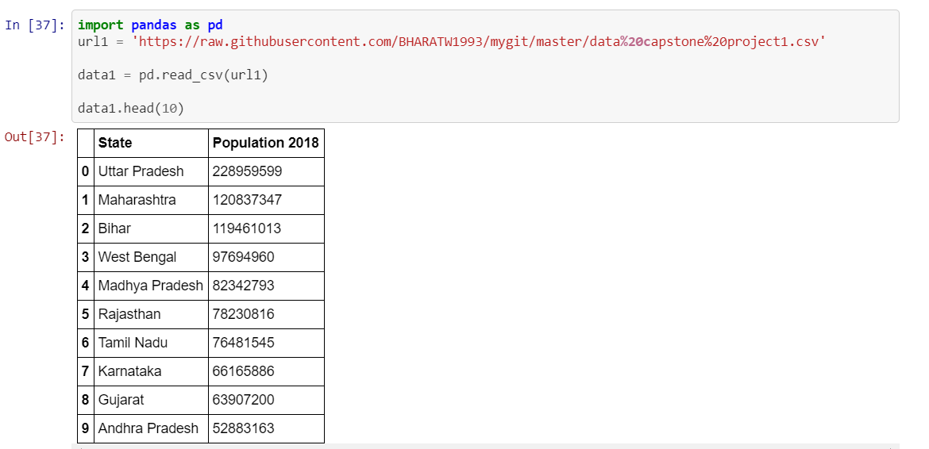
Procedure and expectation
Importing ‘Data1’ in Pandas upto 10 data heads

Slide 6
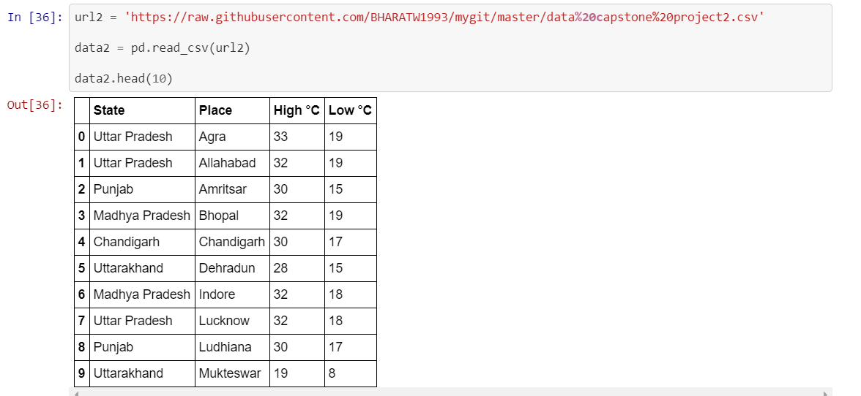
Procedure and expectation
Importing ‘Data2’ in Pandas upto 10 data heads

Slide 7
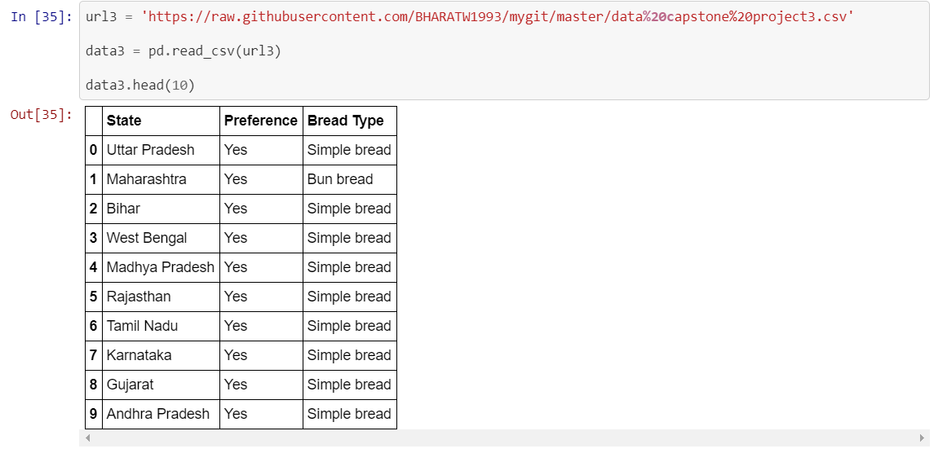
Procedure and expectation
Importing ‘Data1’ in Pandas upto 10 data heads.

Slide 8
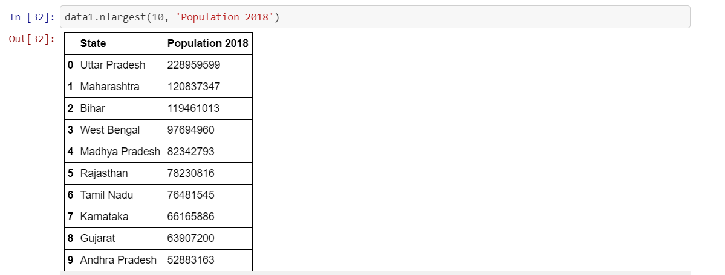
Procedure and expectation
Finding Largest in Data set 1.

Slide 9
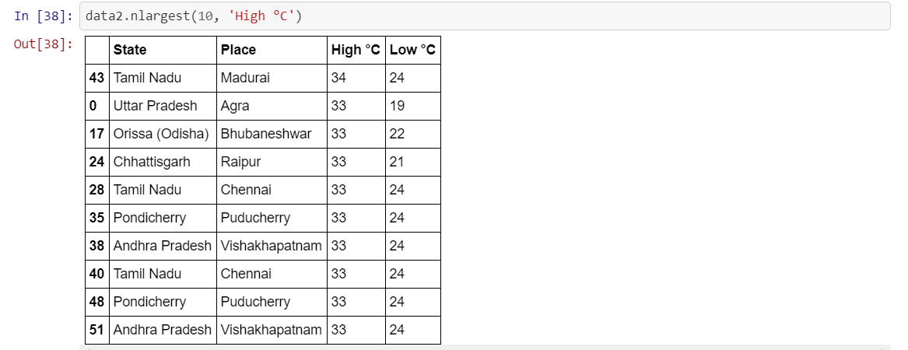
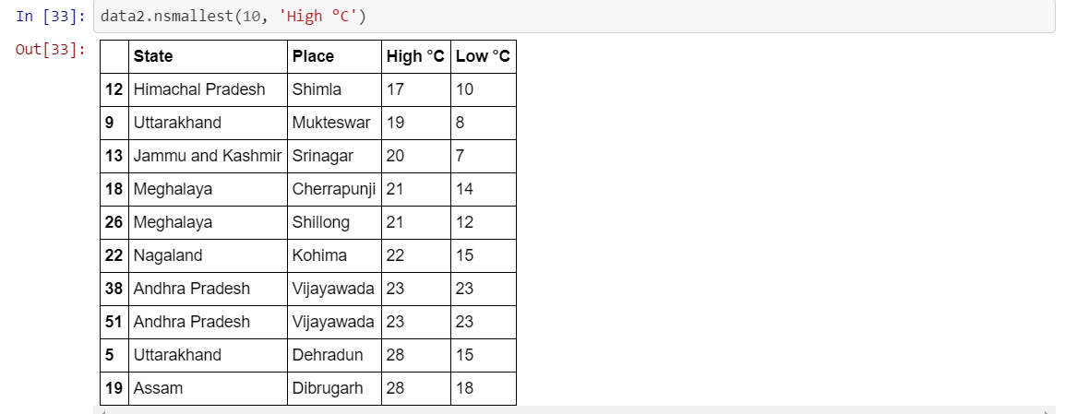
Procedure and expectation
Finding Largest and lowest in data 2 in High Degree Celsius.

Slide 10
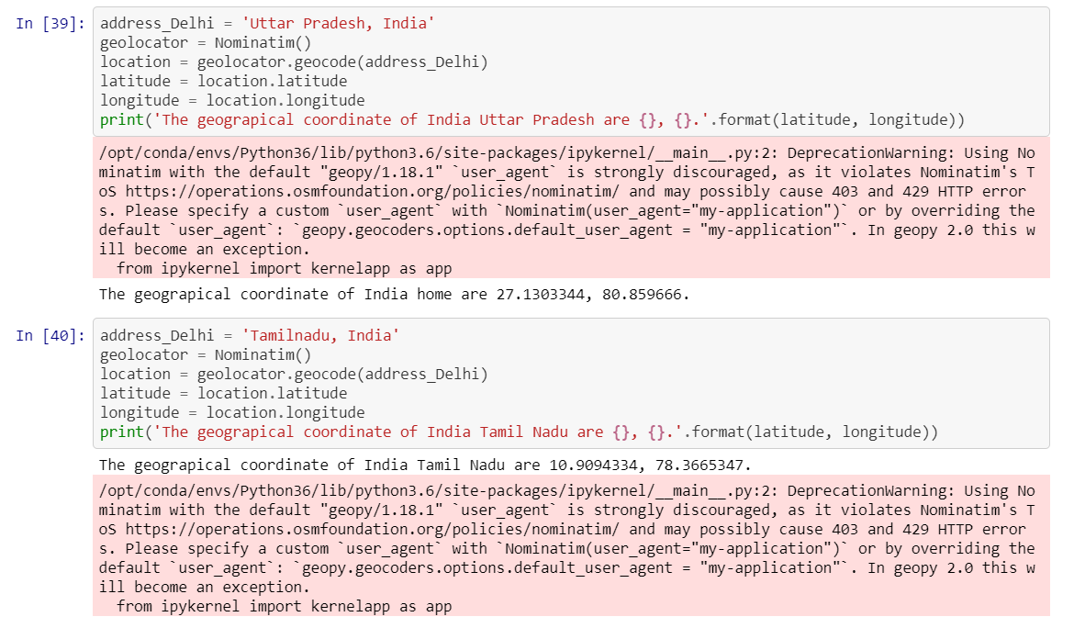
Procedure and expectation
Finding Geo Location using the Geopy.geocode

Slide 11
Results
The first data segment display top 10 highest states having largest population.
The second data displayed the highest and lowest high degree Celsius states of India.
After comparing the states it is found that there are two states which are common in both the list which are Tamil nadu, Uttarpradesh and Andhrapradesh.

Slide 12
Thank you

